Slide 1
BPDA | Brazilian Community Census Analysis
Team member: Zhihao Gu, Chenyang zhang, Minghui Yang, Xiaohan Zou, Pengchao Yuan.

Slide 2
Brazilian Community Census Analysis
Sponsored by Boston Planning & Development Agency (BPDA)
Project goal
Create visualizations using cleaned and processed data.
Identify trends in community demographics (throughout the US).
No background needed for the project
Notes:
The project Goals are divided into two parts, the first part is Create visualizations

Slide 3
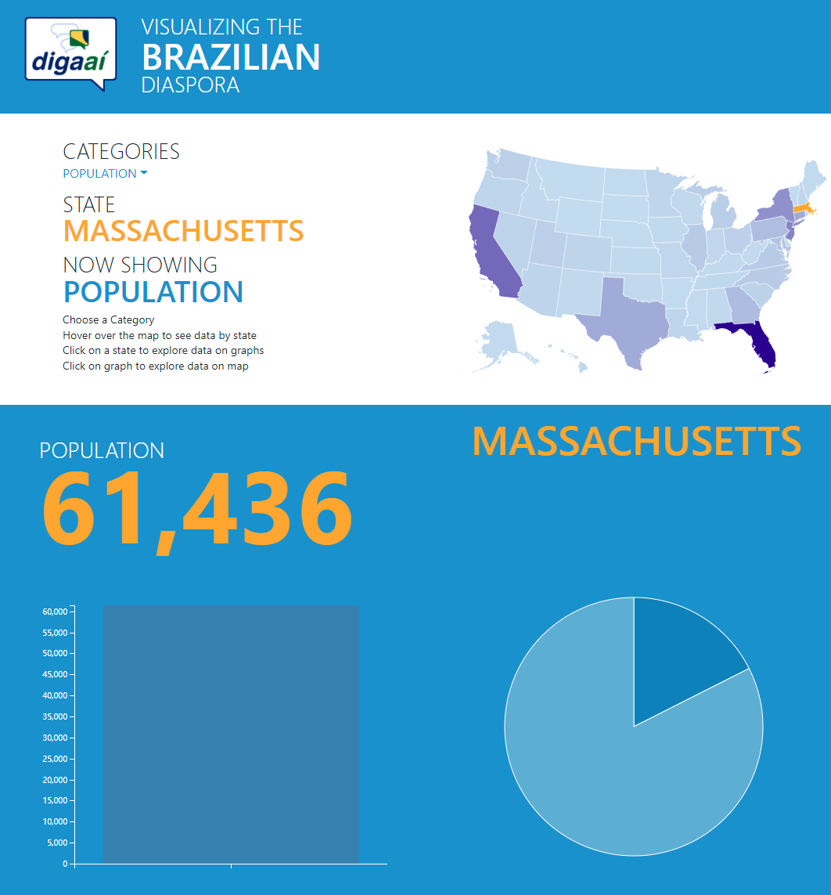
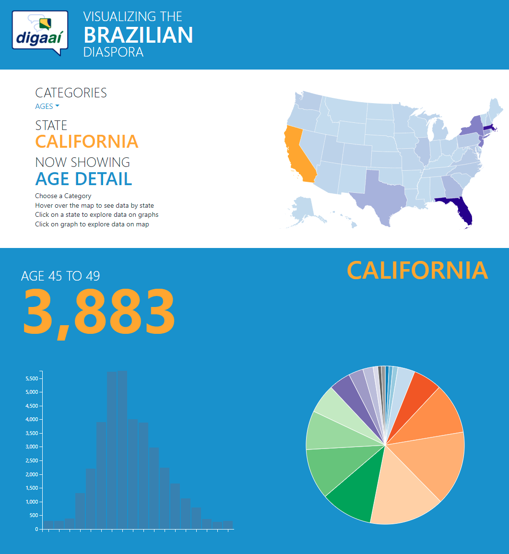
Previous work about Brazilian Community
https://digaai.herokuapp.com/
Notes:
They already have a website to show the data.
Not interactive enough
No comparison
Want: a more interactive way to show data, also find some patterns/trend,

Slide 4
Data
Data are provided
Preprocessed Brazilian Immigrants data
Population
Age distribute
Gender
Marital status
Citizenship
Education
Employment
Income
Both per year and per State
Notes:
We use the same data showed by the website.
Needs to fix error indexes, handle missing data

Slide 5
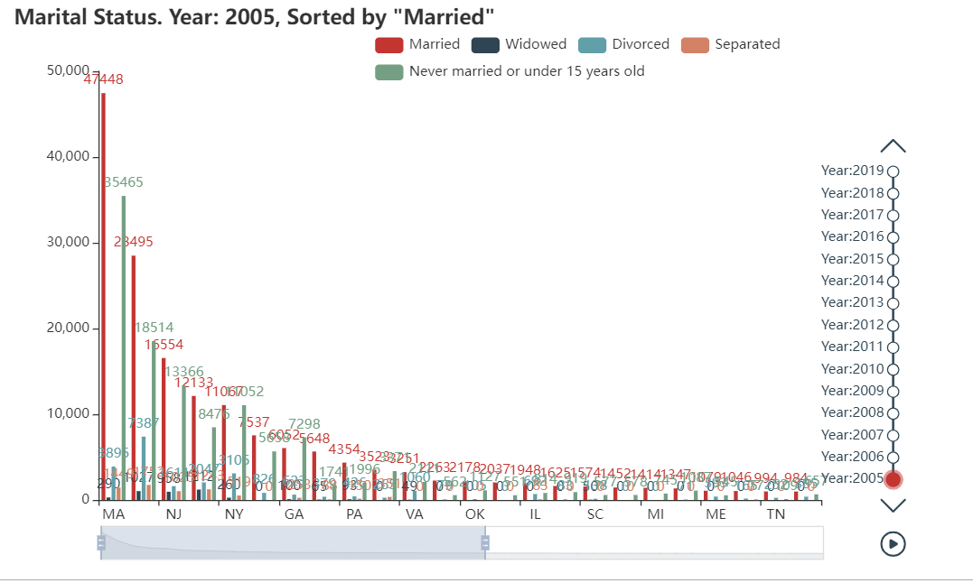
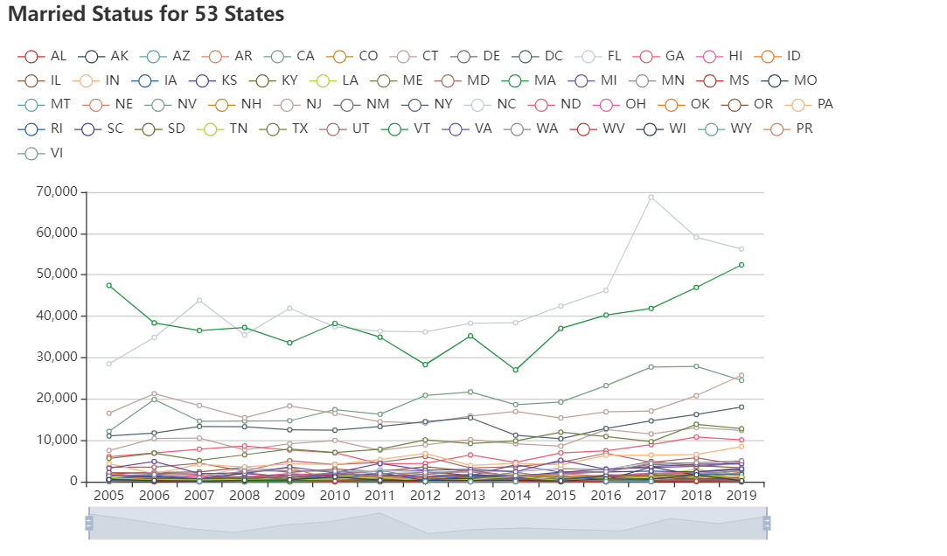
Visualization Part
Visualization by state
Visualization by year
Powered by pyecharts, an opensource JavaScript visualization library
Notes:
We use pyecharts to generate visualization.
It is easy to embed, including timeline, interactive, select what we want to display which meets the client’s requirements perfectly
We provide three different type of visualization
First is showing data by states
Second is showing data by year
Using these two types, we can Compare data between years and Compare data between states

Slide 6
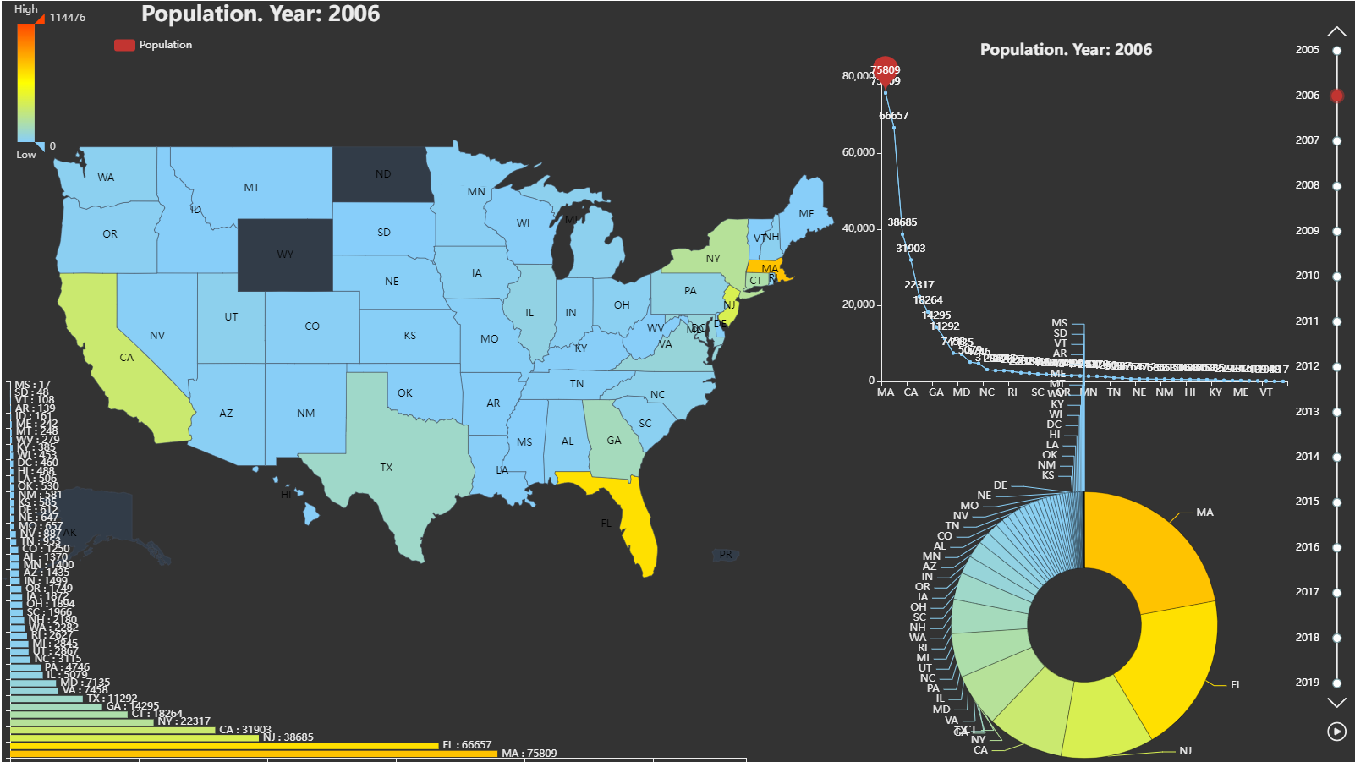
Visualization Part
Visualization by Heat Map
Showing data on the map
Color represents absolute value
Geographically related
Combining with Pie chart to show the proportion within US
Notes:
The third type is showing data on the map using heatmap combining with Pie chart, to a give a straightforward look how the data distributed among the country.

Slide 7
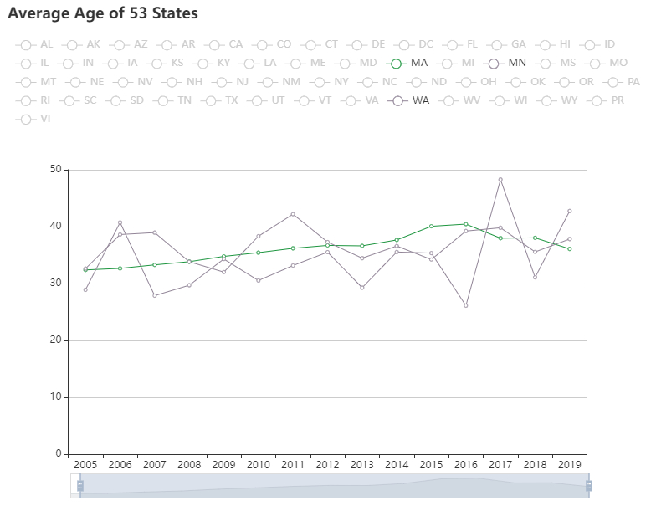
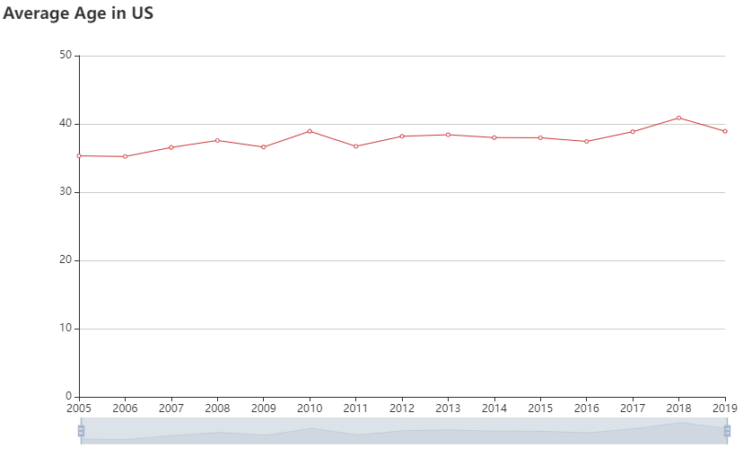
Analysis Part
Analyze the trends or patterns in the data
focus on
Population
Gender
Age
Income
Employment
Education
Notes:
For analysis part, We try to find if there is a special trends that how data changes among years.
Focus on population, gender, age, income, employment and education
On the right side is the average age information and we can see the average age in US gradually increase from 2005 to 2019. And we can also see the average age in MA matches with this trend, represented by green line.

Slide 8
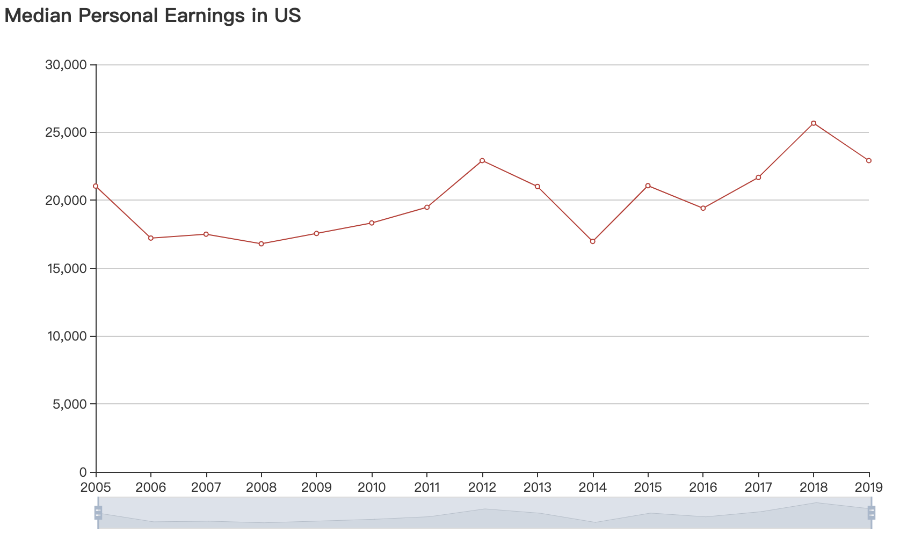
Analysis Part – Income Example
Increasing from 2006 to 2012
Decreasing from 2012 to 2014
Increasing again from 2016 to 2018
Notes:
Here, we give a more specific example of income among the country.
Income Increasing from 2006 to 2012; Decreasing from 2012 to 2014; and then Increasing again from 2016 to 2018

Slide 9
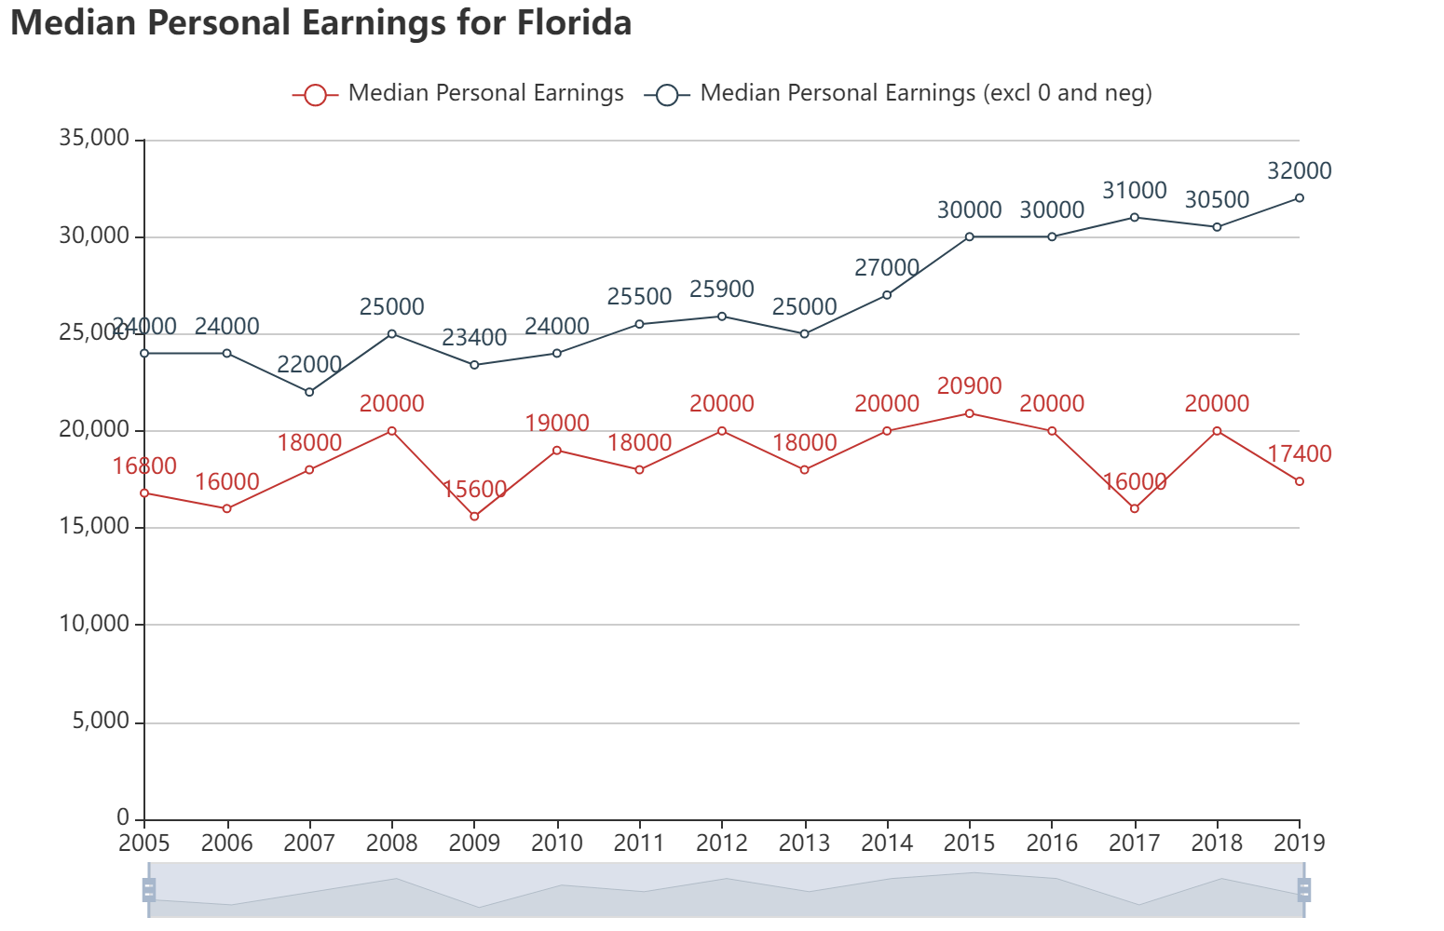
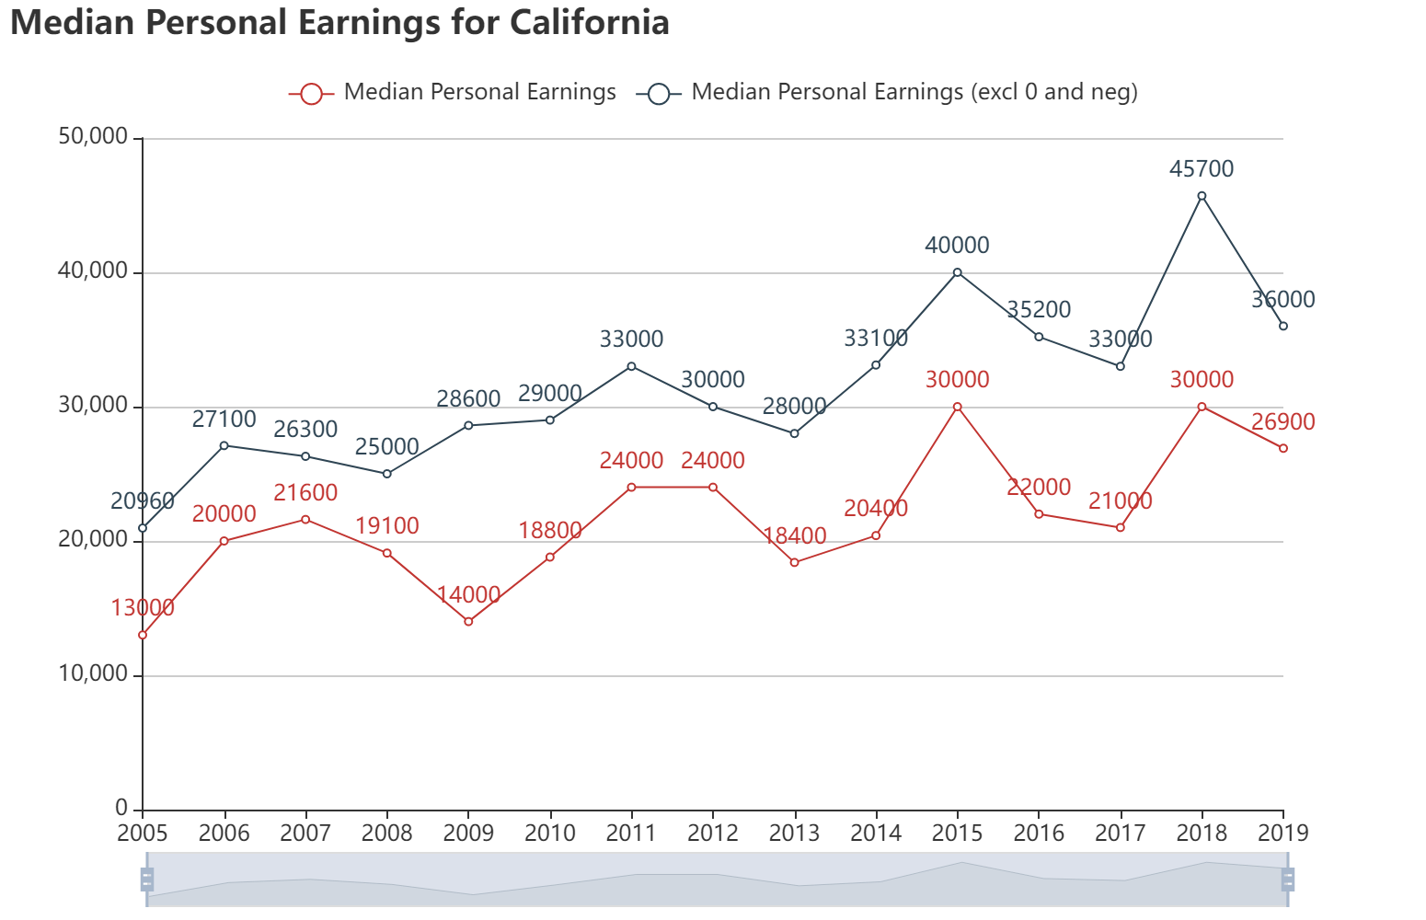
Analysis Part – Income Example
Increasing pattern for MA, CA, CT, FL, MI, NJ, NY, PA, TX.
Notes:
For some states such Florida, California, the income gradually increases among these years with some fluctuation.

Slide 10
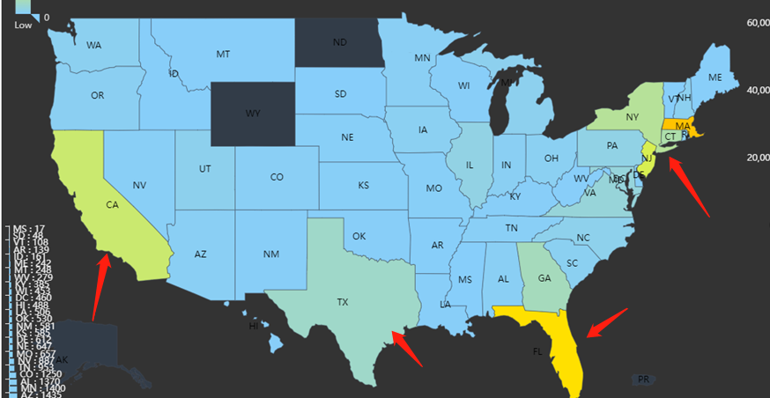
Analysis Part – Income Example
Increasing pattern for MA, CA, CT, FL, MI, NJ, NY, PA, TX.
Notes:
And if we look at the previous heatmap about population, these states have high population corelated to the increasing income pattern.

Slide 11
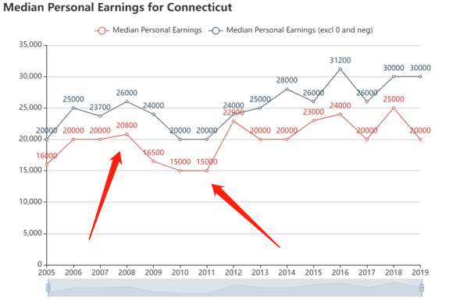
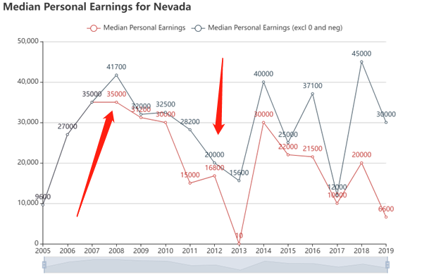
Analysis Part – Income Example
Decreasing pattern from 2008 to 2012 for AZ, CO, CT, MD, NJ, NV.
Notes:
Another trend is the decreasing pattern during 2008 to 2012. lots of states experienced income decreasing, and we assume this is due to the global financial crisis.

Slide 12
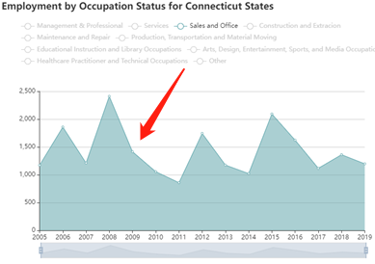
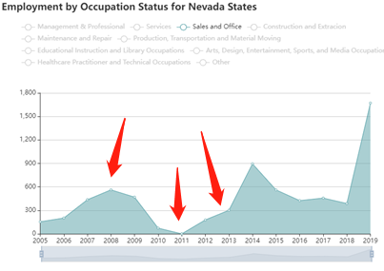
Analysis Part – Income Example
Decreasing pattern around 2008 to 2012 for AZ, CO, CT, MD, NJ, NV.
Related to employment?
Sales and Office as example
Notes:
And we try to figure out if something is related to this pattern.
We exam the employment status for this two states. We can see the Sale and Office category also drops among these years.
But we do not know the downward economy leads to less sales jobs or the less sales jobs leads to a lower income.
And if we see the graph more carefully, then we can see the income in Nevada keep dropping until 2013 while the sales occupation began to increase from 2011.
So, it is really hard to tell the relations between data.

Slide 13
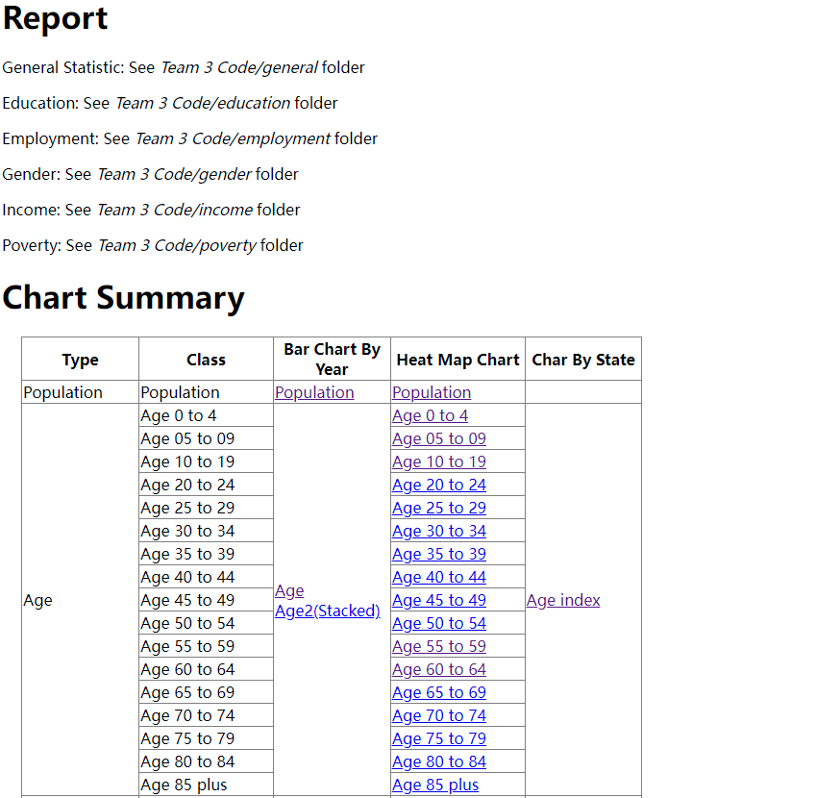
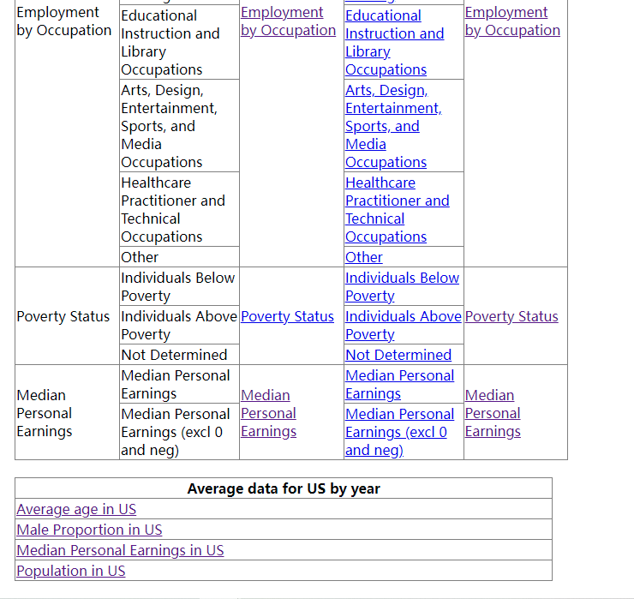
Portal Site
We add a portal web page to guide through all kinds of plot.
Notes:
At the end, because we made quite a lot of charts, we also make a simple portal website to organize all the plots.
It includes all directory information about the analysis documents and charts about each category.
It can be found in the git repo.

Slide 14
Challenge & Limitation
Challenges
Visualization should allow the user to set date parameters.
Visualization including timeline.
The chart can be embedded into website.
Sort the data in descending order, show top 10 states.
Some patterns of demographics data are hard to predict.
Limitation
Data must be pre-sort by code.
Some features such as gender proportion changes rapidly and is unable to predict and analyze.
Relations between data are hard to tell.
Notes:
As mentioned before, the challenges and limitations are mostly about to analyze the data because there are too many features to analyze and some features changes too rapidly.

Slide 15
Divide labor:
We divide labor equally and adapted to personal skills.
Plot by year: Zhihao Gu, Pengchao Yuan
Plot by states: Minghui yang, Xiaohan Zou
Data process: Chenyang Zhang
Heat Map: Pengchao Yuan
Data Analysis:
Age, Gender: Chenyang Zhang
Income: Zhihao Gu
Education: Minghui Yang
Employment: Xiaohan Zou
Poverty: Pengchao Yuan
Early Insight: Zhihao Gu
Final Presentation: Pengchao(presentation), Zhihao(slide)
Notes:
We divide labor equally and adapted to personal skills.

Slide 16
Thank You

